Slide 1
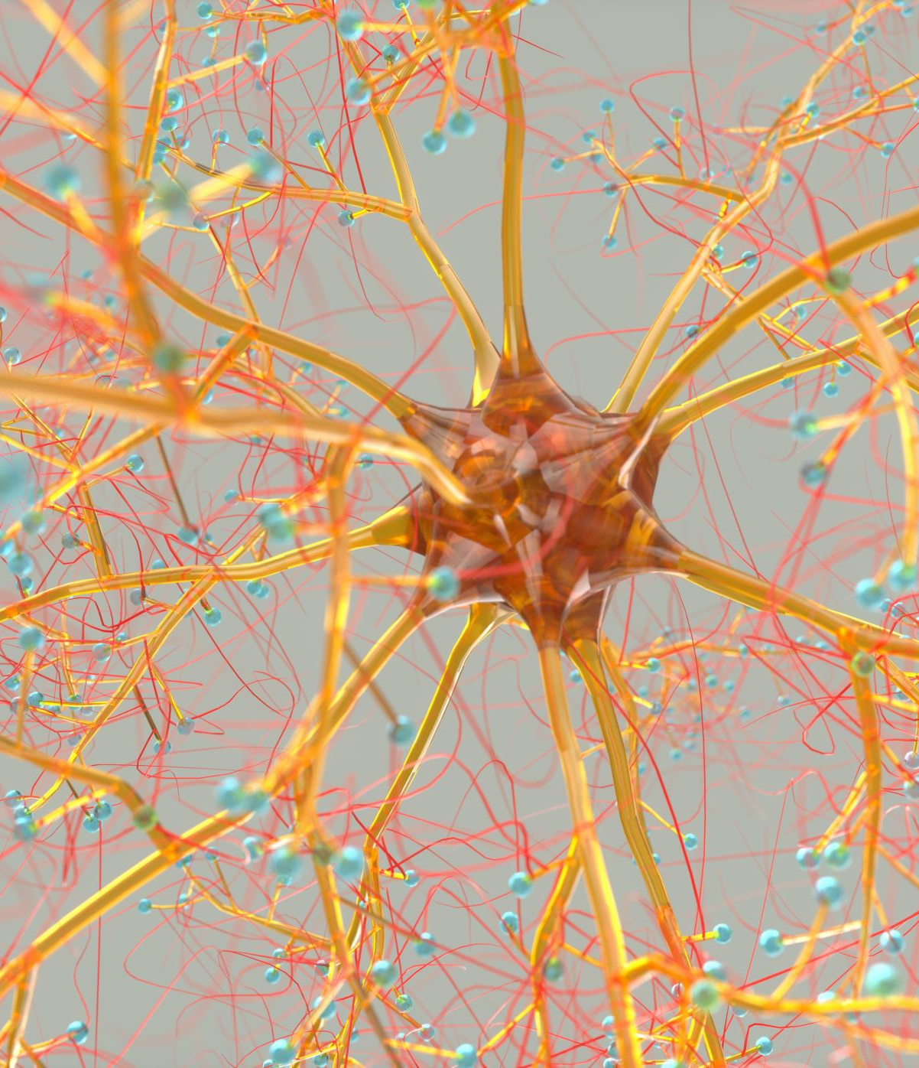


Izhikevich Neuron Model for Embedded Systems
Stephan C. Barros & Vinicius C. Teixeira

Slide 2
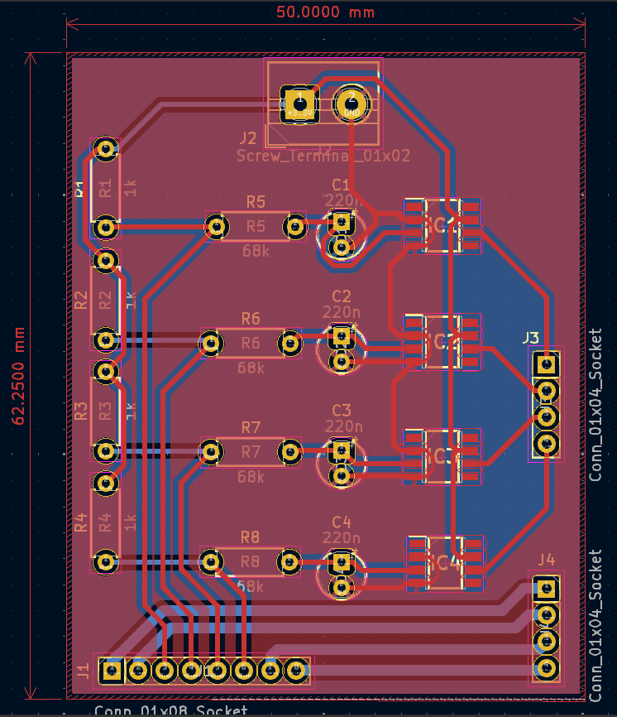
Electrical Scheme
The Nucleo Board has 3 ADCs, each with 12 channels
The rows of the 4x4 matrix will be connected to an operational amplifier which will, in turn, perform impedance matching with the ADC1 channels and allow only low frequencies to pass
The columns of the 4x4 sensor will be connected to 4 GPIOs of the Nucleo Board

Slide 3
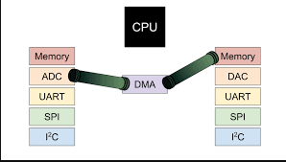
ADC with Direct Memory Access (DMA)
It is a feature present in microcontrollers such as the STM32 that allows data to be transferred between different parts of the system (such as memories and peripherals) autonomously, without constant intervention from the CPU.
Advantages of DMA:
Performance: Increases data transfer speed, as the CPU does not need to manage each byte transferred.
Efficiency: Frees up the CPU to perform other tasks, optimizing the use of the microcontroller.
Flexibility: Allows transfers between different types of peripherals and memories.

Slide 4
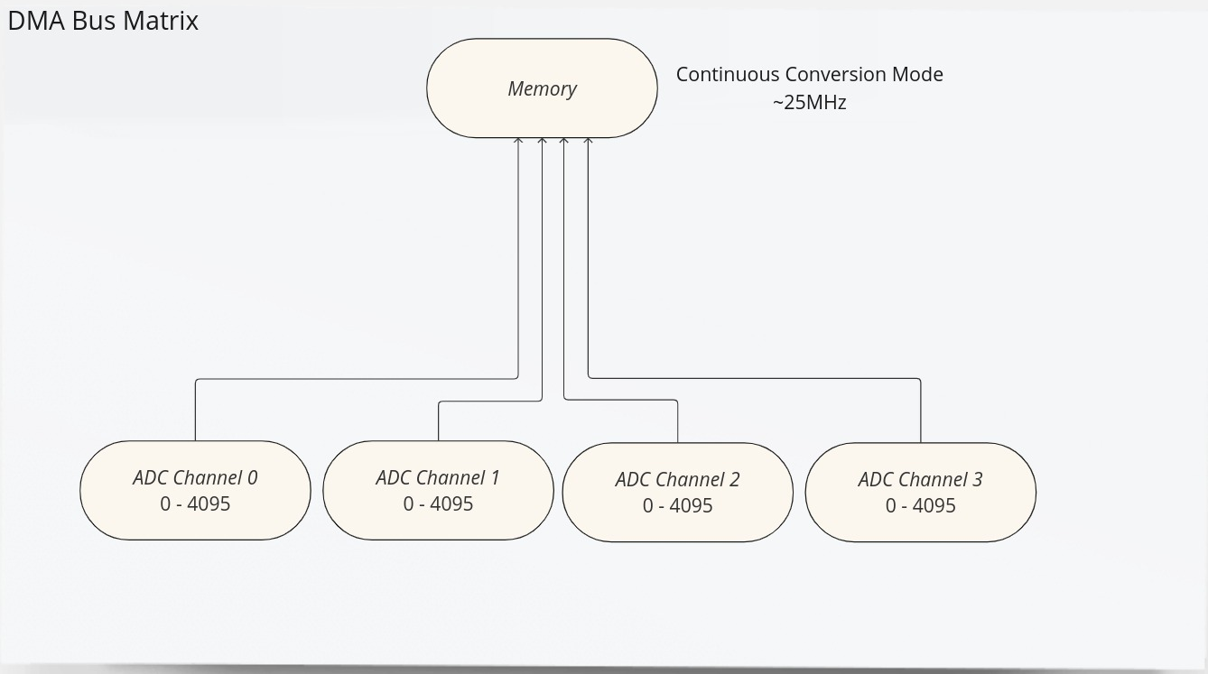
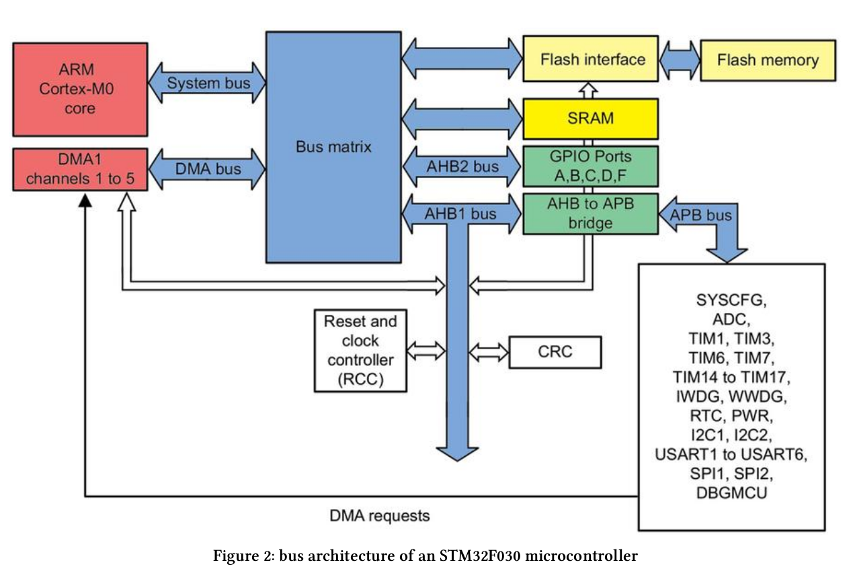
ADC configuration

Slide 5
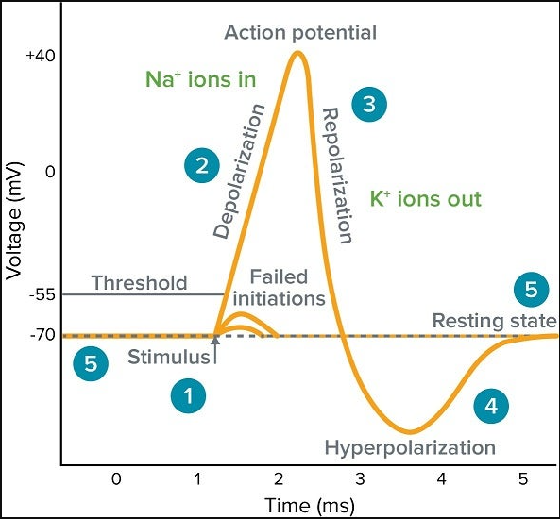
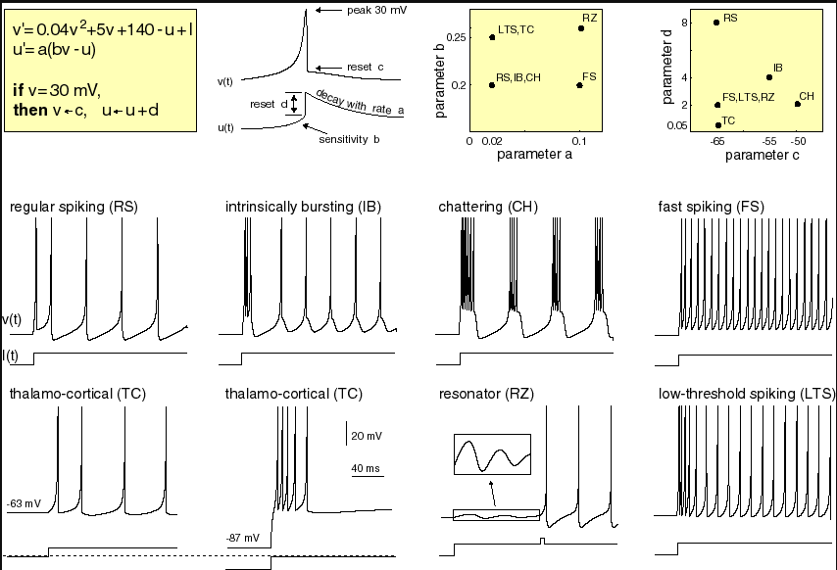
Izhikevich Model
The Izhikevich model is a mathematical tool that simulates the behavior of neurons. It is one of several "simplified schematics" of a real neuron, allowing to study how neurons produce action potentials without the complexity of a full biological neuron.

Slide 6

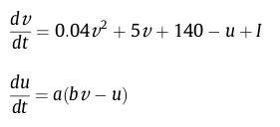
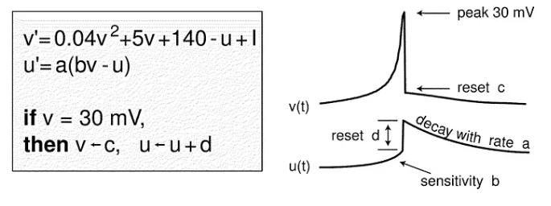
Izhikevich Model
a = time scale of recovery variable u. Magnitude is proportional to recovery speed (small = slower recovery time). A typical value of 0.02
b = sensitivity of u to the fluctuations in v. The bigger the value, the more their coupled, meaning the more there are subthreshold oscillations and low threshold spiking. A typical value of 0.2.
b < a = saddle-node bifurcation in the resting state
b > a = Andronov-Hopf bifurcation in the resting state
c = after-spike reset value of v. A typical value of -65mV
d = after-spike reset value of u. A typical value of 2

Slide 7
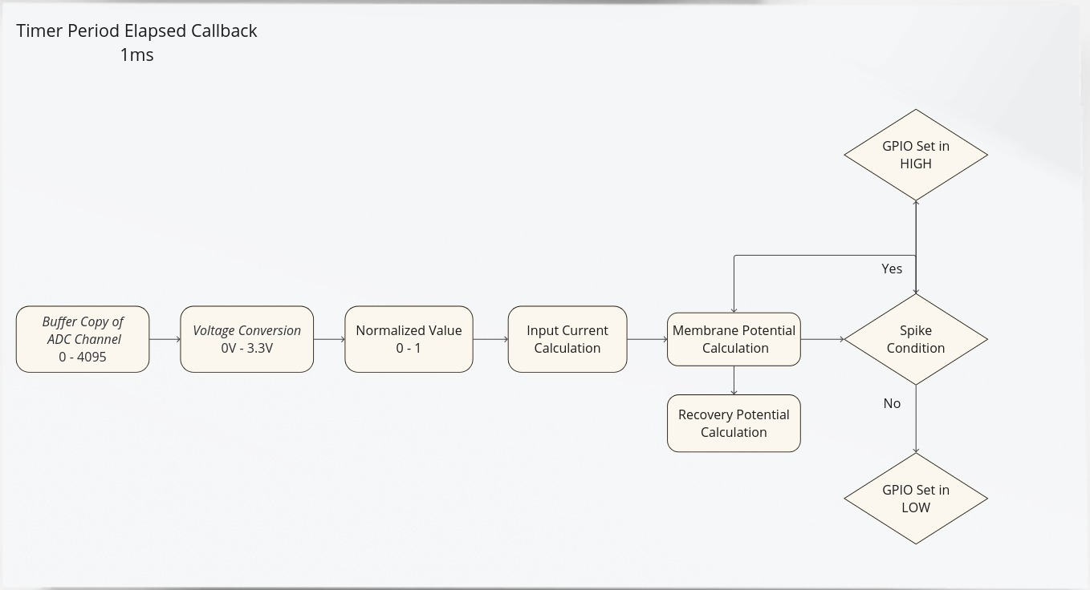
IZHIKEVICH ALGORITHM
u = u + d
v_m = 30mV
Vnorm = ( V – Vmin ) / ( Vmax – Vmin )
V = (ADC*) x 3.3/ 4095
IFA = G x dV/dt

Slide 8
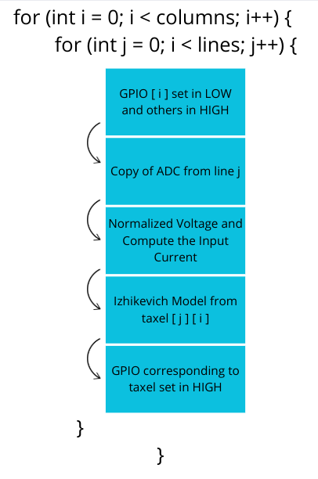
Program flow of Izhikevich model
The STM32's programmed Timer generates an interrupt every 1ms, and activates an Interrupt Service Routine (ISR), which is a callback function, which works as follows:
i = 0
i = 0
i = 0
i = 0
j = 0
j = 1
j = 2
j = 3
i = 1
i = 1
i = 1
i = 1
j = 0
j = 1
j = 2
...
j = 3

Slide 9
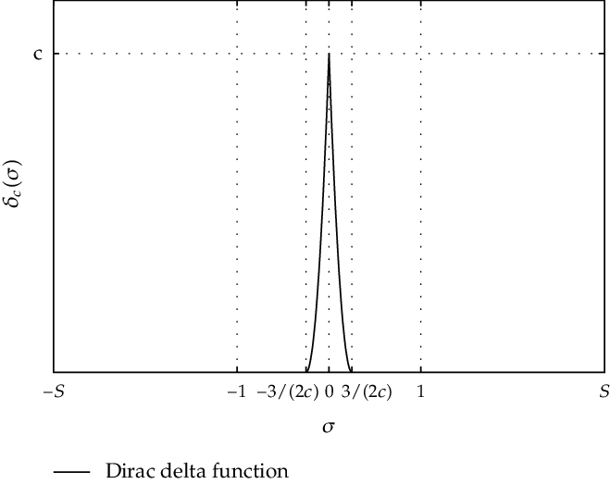
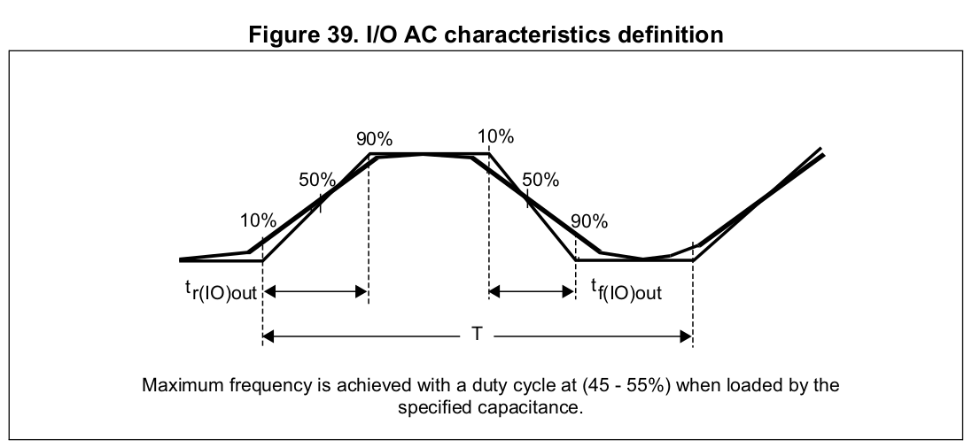
SPIKE APPROXIMATION IN GPIO
We cannot generate a single impulse with the GPIO because it has a specific rise and fall time. We need to calculate this time to determine if our model's time step (dt) is sufficiently larger than the GPIO's response time.

Slide 10
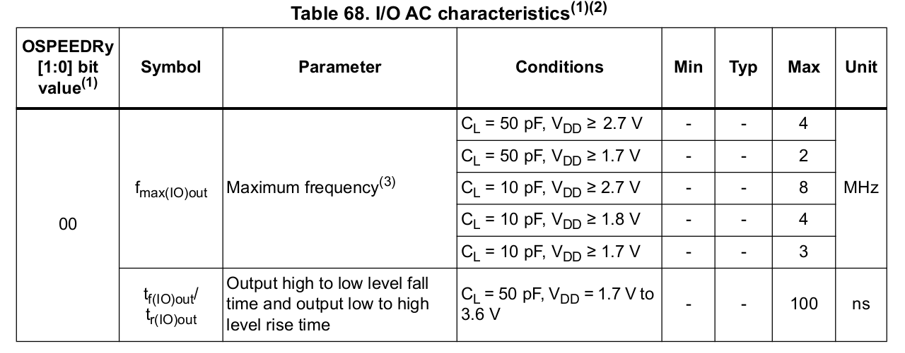
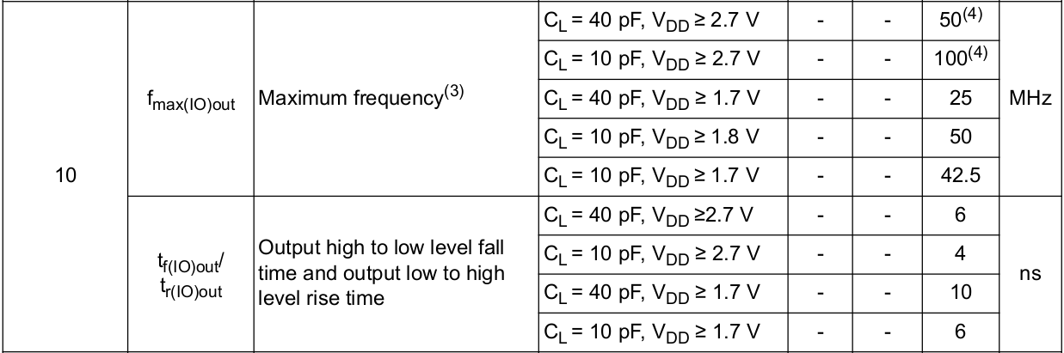
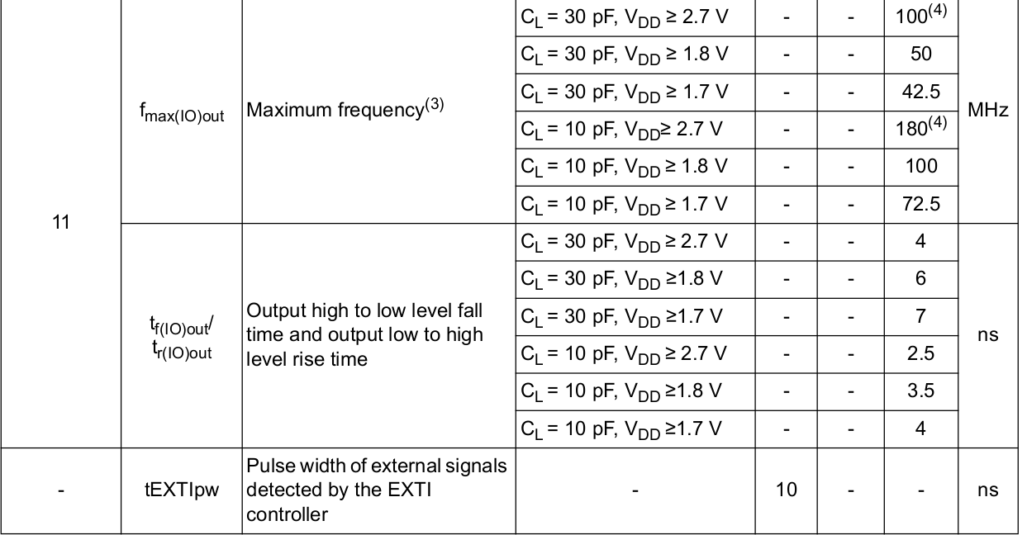
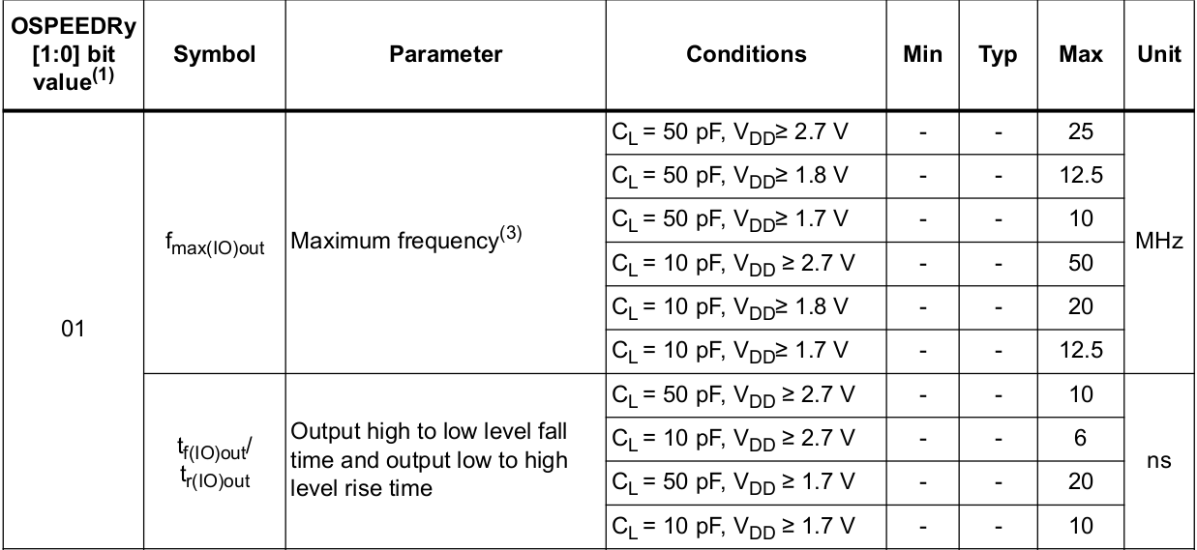
datasheet
We consider the maximum capacitance because we are using 20 GPIOs.
I chose the High Speed Mode (10) -> 6 nanoseconds

Slide 11
Approach
ADC single-channel conversion: 16.4μs
Channel multiplexing: 67ns x 4 (rows) x 4 (columns) = 1.072μs
Total time conversion: 16.4μs x 4 (columns) x 4 (rows) = 262.4μs + 1.072μs
Falling and Rising GPIO: 6ns
Total time of pulses: 6ns x 2 (fall & rise) x 16 (taxels) = 192ns
Columns switch: 100ns x 3 = 300ns
Total time = 263.76μs -> dt = 2ms -> 7.6 times larger

Slide 12
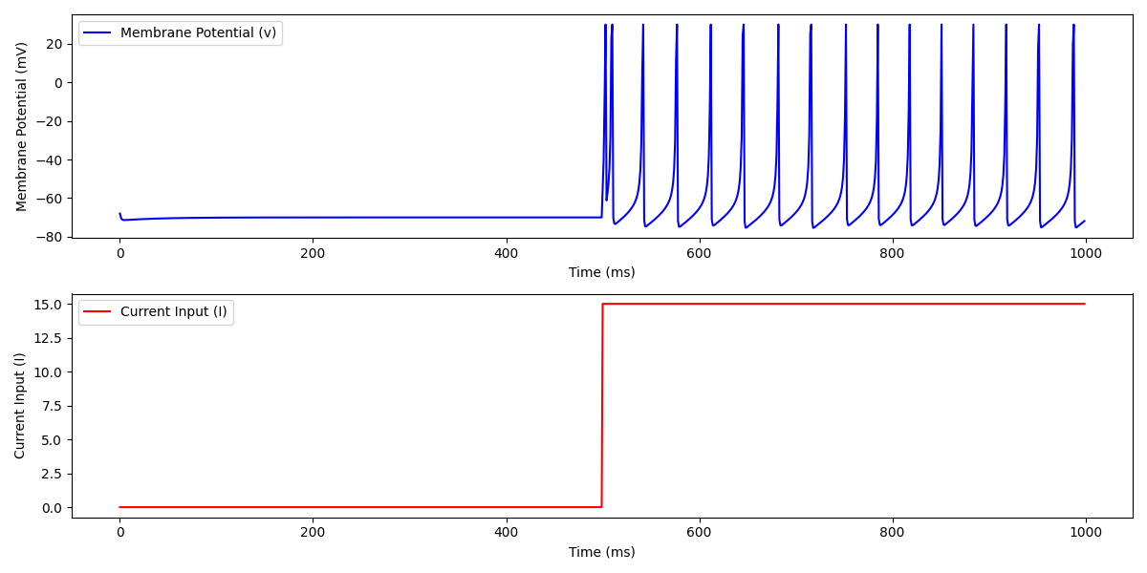
Simulation for a single taxel with a step response

